Slide 1
Data Communication And Networking
Chapter one
Introduction:-
Data Communication: - When we communicate, we are sharing information. This sharing can be local or remote. Between individuals, local communication usually occurs face to face, while remote communication takes place over distance. The term telecommunication, which includes telephony, telegraphy, and television, means communication at a distance (tele is Greek for "far"). The word data refers to information presented in whatever form is agreed upon by the parties creating and using the data. Data communications are the exchange of data between two devices via some form of transmission medium such as a wire cable. For data communications to occur, the communicating devices must be part of a communication system made up of a combination of hardware (physical equipment) and software (programs). The effectiveness of a data communications system depends on four fundamental characteristics: delivery, accuracy, timeliness, and jitter.
Delivery. The system must deliver data to the correct destination. Data must be received by the intended device or user and only by that device or user.
Accuracy. The system must deliver the data accurately. Data that have been altered in transmission and left uncorrected are unusable.
Timeliness. The system must deliver data in a timely manner. Data delivered late are useless. In the case of video and audio, timely delivery means delivering data as they are produced, in the same order that they are produced, and without significant delay. This kind of delivery is called real-time transmission.
Jitter. Jitter refers to the variation in the packet arrival time. It is the uneven delay in the delivery of audio or video packets. For example, let us assume that video packets are sent every 3D ms.If some of the packets arrive with 3D-ms delay and others with 4D-ms delay, an uneven quality in the video is the result.
Components of a data communication system
The five components of data communication system are: - (as shown in fig (1))
Message. The message is the information (data) to be communicated. Popularforms of information include text, numbers, pictures, audio, and video.
Sender. The sender is the device that sends the data message. It can be a computer,workstation, telephone handset, video camera, and so on.
Receiver. The receiver is the device that receives the message. It can be a computer, workstation, telephone handset, television, and so on.
Transmission medium. The transmission medium is the physical path by which a message travels from sender to receiver. Some examples of transmission mediainclude twisted-pair wire, coaxial cable, fiber- optic cable, and radio waves.

Slide 2
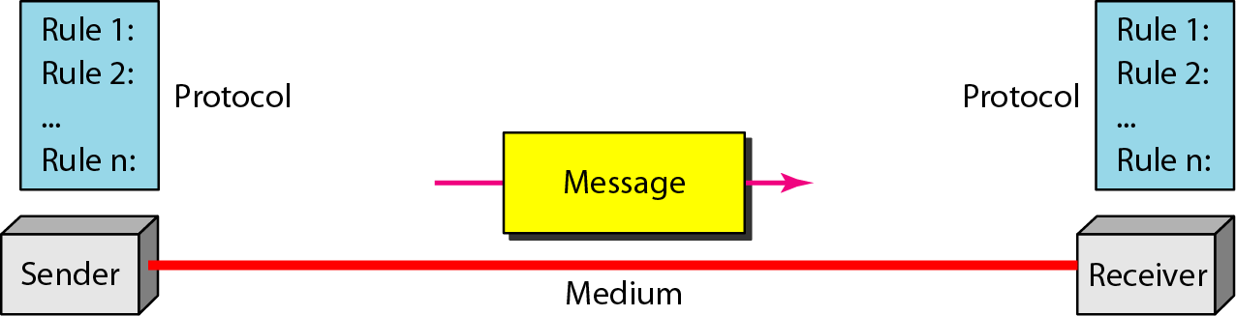
5- Protocol. A protocol is a set of rules that govern data communications. It represents an agreement between the communicating devices. Without a protocol, two devices may be connected but not communicating, just as a person speaking Frenchcannot be understood by a person who speaks only Japanese.
Figure (1)
Data Representation
Information today comes in different forms such as text, numbers, images, audio, and video.
Text: - In data communications, text is represented as a bit pattern, a sequence of bits (Os’ or 1s). Different sets of bit patterns have been designed to represent text symbols. Each set is called a code, and the process of representing symbols is called coding. Today, the prevalent coding system is called Unicode, which uses 32 bits to represent a symbol or character used in any language in the world. The American Standard Code for Information Interchange (ASCII) developed some decades ago in the United States, now constitutes the first 127 characters in Unicode and is also referred to as Basic Latin.
Numbers: - Numbers are also represented by bit patterns. However, a code such as ASCII is not used to represent numbers; the number is directly converted to a binary number to simplify mathematical operations.
Images: - Images are also represented by bit patterns. In its simplest form, an image is composedof a matrix of pixels (picture elements), where each pixel is a small dot. The size of thepixel depends on the resolution. For example, an image can be divided into 1000 pixelsor 10,000 pixels. In the second case, there is a better representation of the image (betterresolution), but more memory is needed to store the image.After an image is divided into pixels, each pixel is assigned a bit pattern. The sizeand the value of the pattern depend on the image. For an image made of only blackand-white dots (e.g., a chessboard), a 1-bit pattern is enough to represent a pixel.
Audio: - Audio refers to the recording or broadcasting of sound or music. Audio is by nature different from text, numbers, or images. It is continuous, not discrete. Even when we use a microphone to change voice or music to an electric signal, we create a continuous signal.

Slide 3
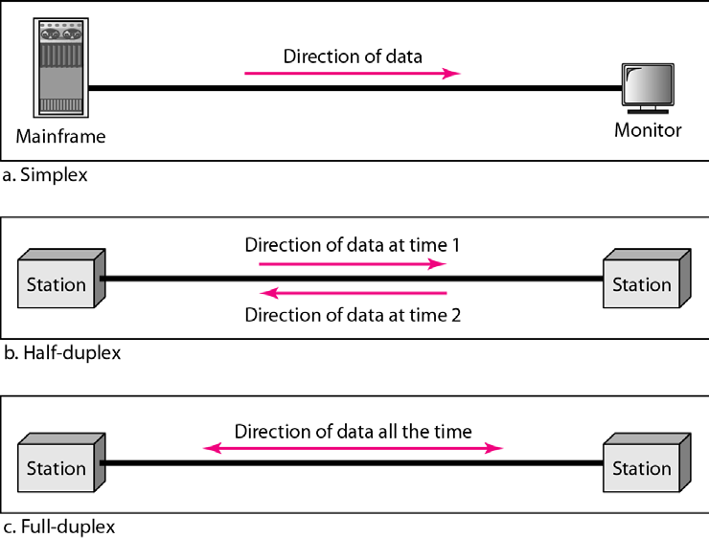
Video: - Video refers to the recording or broadcasting of a picture or movie. Video can either be produced as a continuous entity (e.g., by a TV camera), or it can be a combination of images, each a discrete entity, arranged to convey the idea of motion.
Data Flow
Communication between two devices can be simplex, half-duplex, or full-duplex as shown in Figure 1.2.
Figure (1.2)
Simplex: - In simplex mode, the communication is unidirectional, as on a one-way street. Only one of the two devices on a link can transmit; the other can only receive (see Figure 1.2a). Keyboards and traditional monitors are examples of simplex devices. The keyboard can only introduce input; the monitor can only accept output. The simplex mode can use the entire capacity of the channel to send data in one direction.
Half-Duplex: - In half-duplex mode, each station can both transmit and receive, but not at the same time. When one device is sending, the other can only receive, and vice versa (see Figure 1.2b). The half-duplex mode is like a one-lane road with traffic allowed in both directions. When cars are traveling in one direction, cars going the other way must wait. In a half-duplex transmission, the entire capacity of a channel is taken over by whichever of the two devices is transmitting at the time. Walkie-talkies and CB (citizens band) radios are both half-duplex systems. The half-duplex mode is used in cases where there is no need for communication in both directions at the same time; the entire capacity of the channel can be utilized for each direction.
Full-Duplex: - In full-duplex mode (also called duplex), both stations can transmit and receive simultaneously (see Figure 1.2c). The full-duplex mode is like a two-way street with trafficflowing in both

Slide 4
directions at the same time. In full-duplex mode, signalsgoing in one direction share the capacity of the link: with signals going in the other direction.This sharing can occur in two ways: Either the link must contain two physically separate transmission paths, one for sending and the other for receiving; or the capacity of the channel is divided between signals traveling in both directions. One common example of full-duplex communication is the telephone network. When two people are communicating by a telephone line, both can talk and listen at the same time.
The full-duplex mode is used when communication in both directions is required all the time. The capacity of the channel, however, must be divided between the two directions.
NETWORKS
A network is a set of devices (often referred to as nodes) connected by communication links. A node can be a computer, printer, or any other device capable of sending and/or receiving data generated by other nodes on the network.
Most networks use distributed processing, in which a task is divided among multiplecomputers. Instead of one single large machine being responsible for all aspects of process, separate computers (usually a personal
computer or workstation) handle asubset.
Network Criteria
A network must be able to meet a certain number of criteria. The most important of these are:- 1- Performance.
Reliability.
Security.
Performance: - Performance can be measured in many ways, including transit time and response time.
Transit time is the amount of time required for a message to travel from one device to another. Response time is the elapsed time between an inquiry and a response. The performance of a network
depends on a number of factors, including the number of users,the type of transmission medium, the capabilities of the connected hardware, and the efficiency of the software. Performance is often evaluated by two networking metrics: throughput and delay.We often need more throughputs and less delay. However, these two criteria are often contradictory. If we try to send more data to the network, we may increase throughput but we increase the delay because of traffic congestion in the network.
Reliability: - In addition to accuracy of delivery, network reliability is measured by the frequency of failure, the time it takes a link to recover from a failure, and the network's robustness ina catastrophe.
Security: - Network security issues include protecting data from unauthorized access, protecting data from damage and development, and implementing policies and procedures forrecovery from breaches and data losses.
Network Connection

Slide 5
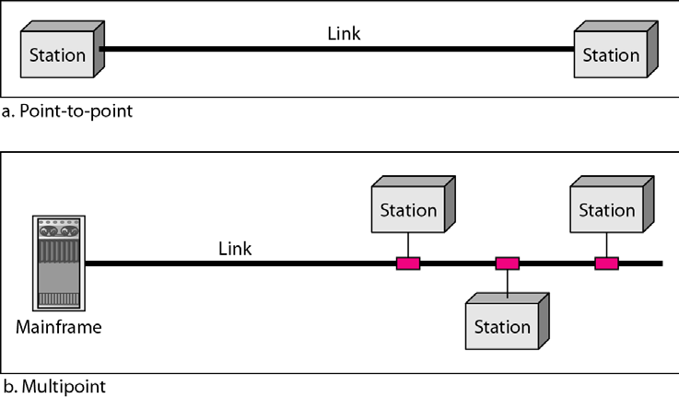
Type of connection: -A network is two or more devices connected through links. A link is a communications pathway that transfers data from one device to another.There are two possible types of connections: point-to-point and multipoint.
Point-to-Point:- (single transmitter and receiver) a point-to-point connection provides a dedicated link between two devices. The entire capacity of the link is reserved for transmission between those two devices. Most point-to-point connections use an actual length of wire or cable to connect the two ends, but other options, such as microwave or satellite links, are also possible (see Figure 1.3a).
Multipoint A multipoint: - (multiple recipients of single transmission)(also called multi-drop) connection is one in which more than two specific devices share a single link (see Figure 1.3b). In a multipoint environment, the capacity of the channel is shared, either spatially or temporally. If several devices can use the link simultaneously, it is a spatially shared connection. If users must take turns, it is a timeshared connection.
Figure (1.3)
Note: - The physical topology is an arrangement of the nodes and the physical connections betweenthem. The representation of how the media is used to interconnect the devices is the physicaltopology.
Note: - logical topology is the way a network transfers frames from one node to the next. This arrangement consists of virtual connections between the nodes of a network independent of their physical layout
Physical Topology

Slide 6
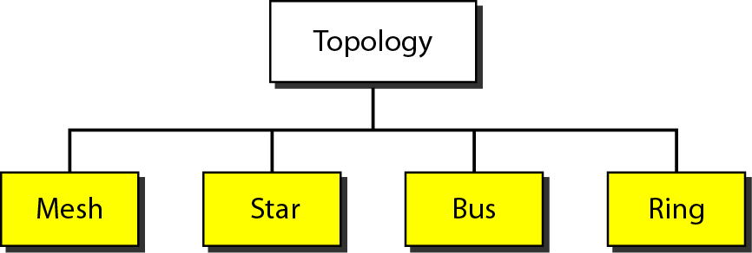
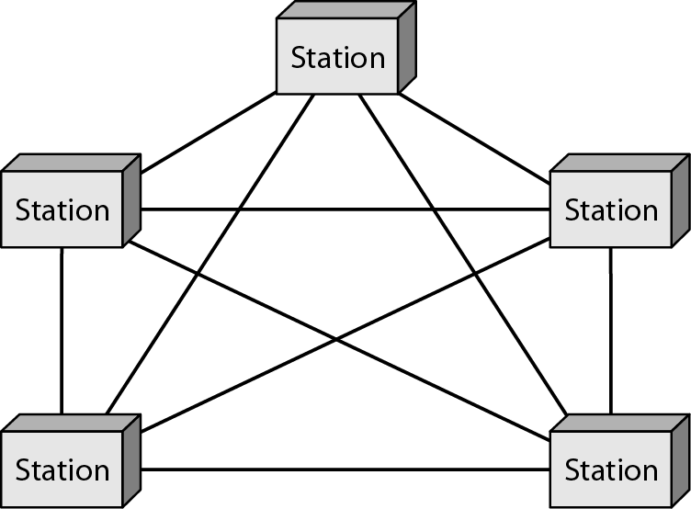
The term physical topology refers to the way in which a network is laid out physically two or more devices connect to a link; two or more links form a topology. The topology of a network is the geometric representation of the relationship of all the links and linking devices (usually called nodes) to one another. There are four basic topologies possible: mesh, star, bus, and ring (see Figure 1.4).
Figure (1.4)
Mesh topology: -In a mesh topology, every device has a dedicated point-to-point link to every other device. The term dedicated means that the link carries traffic only between the two devices it connects. To find the number of physical links in a fully connected mesh network with 𝑛𝑛nodes, we first consider that each node must be connected to every other node. Node 1 must be connected to 𝑛𝑛− 1 nodes, node 2 must be connected to n – 1 node and finally node n must be connected to n - 1 node. We need n (n - 1) physical links. However, if each physical link allows communication inboth directions (duplex mode), we can divide the number of links by 2.
In other words, we can say that in a mesh topology, we needn(n − 1)/2 duplex-mode links.
To accommodate that many links, every device on the network must have (n – 1) input/output (VO) ports (see Figure 1.5) to be connected to the other n - 1 stations.
Figure (1.5) a fully connected mesh topology (five devices)

Slide 7
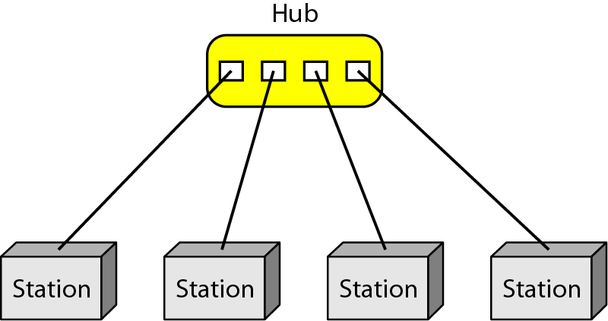
Advantages of mesh topology over other network topologies:-
The use of dedicated links guarantees that each connection can carry its own data load, thus eliminating the traffic problems that can occur when links must be shared by multiple devices.
A mesh topology is robust. If one link becomes unusable, it does not incapacitate the entire system.
There is the advantage of privacy or security. When every message travels along a dedicated line, only the intended recipient sees it. Physicalboundaries prevent other users from gaining access to
messages.
Point-to-point links make fault identification and fault isolation easy. Traffic can be routed to avoid links with suspected problems. This facility enables the network manager to discoverthe precise location of the fault and aids in finding its cause and solution.
The main disadvantages of a mesh are related to the amount of cabling and thenumber of I/O ports required.
Because every device must be connected to everyother device, installation and reconnection are difficult.
The sheer bulk of thewiring can be greater than the available space (in walls, ceilings, or floors) can accommodate.
Finally, the hardware required to connect each link (I/O ports and cable) can beprohibitively expensive.
For these reasons a mesh topology is usually implemented in alimited fashion, for example, as a backbone connecting the main computers of a hybridnetwork that can include several othertopologies.One practical example of a mesh topology is the connection of telephone regionaloffices in which each regional office needs to be connected to every other regional office.
Star topology: - In a star topology, each device has a dedicated point-to-point link only to a central controller, usually called a hub. The devices are not directly linked to one another. Unlike a mesh topology, a star topology does not allow direct traffic between devices. The controller acts as an exchange: If one device wants to send data to another, it sends the data to the controller, which then relays the data to the other connected device (see Figure 1.6).
Figure (1.6) a star topology connecting four stations

Slide 8
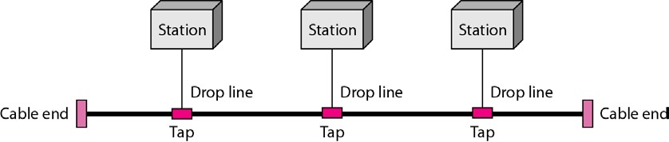
Advantages of star topology:-
A star topology is less expensive than a mesh topology. In a star, each device needs only one link and one I/O port to connect it to any number of others. This factor also makes it easy to install and
reconfigure.
Less cabling needs to be housed, and additions, moves, and deletions involve only one connection: between that device and the hub.
Other advantages include robustness. If one link fails, only that link is affected. All other links remain active. This factor also lends itself to easy fault identification and fault isolation. As long as the hub is working, it can be used to monitor link problems and bypass defective links.
Disadvantage of star topology
1- Dependency of the whole topology on one single point, the hub. If the hub goes down, the whole system is dead.
Although a star requires far less cable than a mesh, each node must be linked to a central hub. For this reason, often more cabling is required in a star than in some other topologies (such as ring or bus). The star
topology is used in local-area networks (LANs),High-speed LANs often use a star topology with a central hub.
Bus Topology: - The preceding examples all describe point-to-point connections. A bus topology, on the other hand, is multipoint. One long cable acts as a backbone to link all the devices in a network (see Figure
1.7). Nodes are connected to the bus cable by drop lines and taps. A drop line is a connection running between the device and the main cable. A tap is a connector that either splices into the main cable or punctures the sheathing of a cable to create a contact with the metallic core. As a signal travels along the backbone, some of its energy is transformed into heat. Therefore, it becomes weaker and weaker as it travels farther and farther. For this reason there is a limit on the number of taps a bus can support and on the distance between those taps.
Figure (1.7) a bus topology connecting three stations
Advantages of a bus topology:-
1- Ease of installation. Backbone cable can be laid along the most efficient path, and then connected to the nodes by drop lines of various lengths. In this way, a bus uses less cabling than mesh or star
topologies. In a star, for example, four network devices in the same room require four lengths of cable reaching all the way to the hub. In a bus, this redundancy is eliminated. Only the backbone cable stretches through the entire facility. Each drop line has to reach only as far as the nearest point on the backbone.
Disadvantages of a bus topology:-

Slide 9
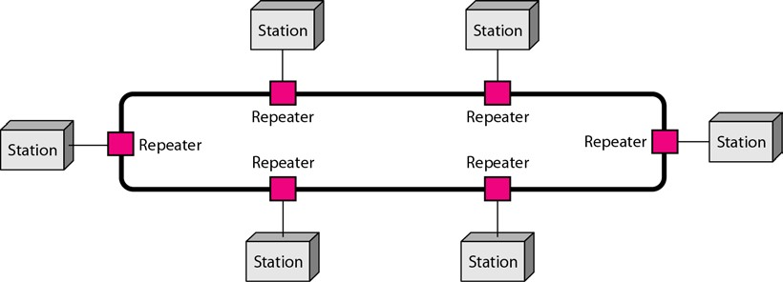
Difficult reconnection and fault isolation. A bus is usually designed to be optimally efficient at installation.
Difficult to add new devices.
Signal reflection at the taps can cause degradation in quality. This degradation can be controlled by limiting the number and spacing of devices connected to a given length of cable.
Adding new devices may therefore require modification or replacement of the backbone.
In addition, a fault or break in the bus cable stops all transmission, even between devices on the same side of the problem. The damaged area reflects signals back in the direction of origin, creating noise in both directions.
Bus topology was the one of the first topologies used in the design of early local area networks. Ethernet LANs can use a bus topology, but they are less popular now.
Ring Topology: - In a ring topology, each device has a dedicated point-to-point connection with only the two devices on either side of it. A signal is passed along the ring in one direction, from device to device, until it reaches its destination. Each device in the ring incorporates a repeater. When a device receives a signal intended for another device, its repeater regenerates the bits and passes them along (see Figure 1.8).
Figure (1.8) a ring topology connecting six stations
A ring is relatively easy to install and reconfigure. Each device is linked to only its immediate neighbors (either physically or logically). To add or delete a device requires changing only two connections. The only constraints are media and traffic considerations (maximum ring length and number of devices). In addition, fault isolation is simplified. Generally in a ring, a signal is circulating at all times. If one device does not receive a signal within a specified period, it can issue an alarm. The alarm alerts the network operator to the problem and its location. However, unidirectional traffic can be a disadvantage. In a simple ring, a break in the ring (such as a disabled station) can disable the entire network. This weakness can be solved by using a dual ring or a switch capable of closing off the break. Ring topology was prevalent when IBM introduced its local-area network Token Ring. Today, the need for higher-speed LANs has made this topology less popular.
Hybrid Topology: - A network can be hybrid. For example, we can have a main star topologywith each branch connecting several stations in a bus topology as shown in Figure 1.9.

Slide 10
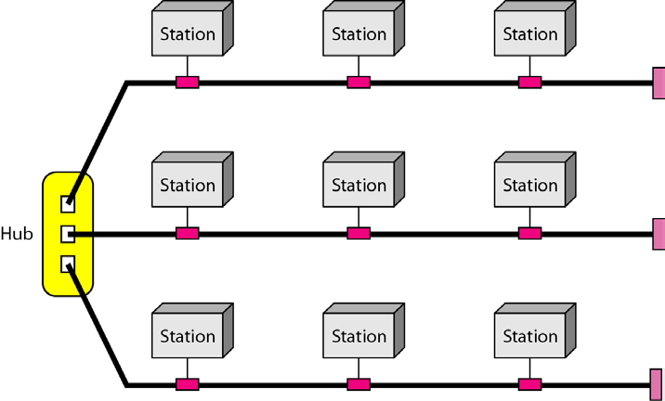
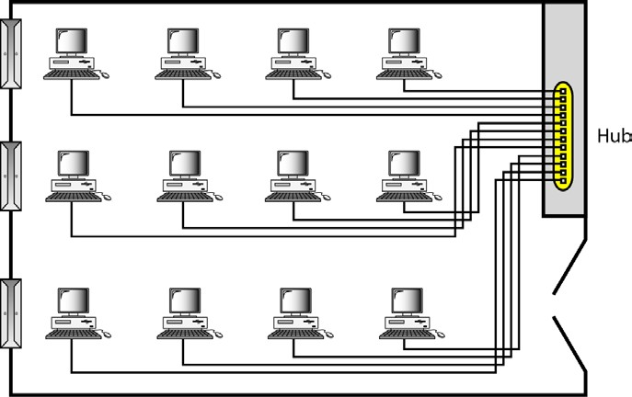
Figure (1.9) a hybrid topology: a star backbone with three bus networks
Categories of Networks: - The category into which a network falls is determined by its size. A LAN normally covers an area less than 2 miles; a WAN can be worldwide. Networks of a size in between are normally referred to as metropolitan area networks and span tens of miles.
Local Area Networks (LANs)
A local area network (LAN) is usually privately owned and links the devices in a singleoffice, building, or campus (see Figure 1.10). Depending on the needs of an organizationand the type of technology used, a LAN can be as simple as two PCs and a printer insomeone's home office; or it can extend throughout a company
and include audio andvideo peripherals. Currently, LAN size is limited to a few kilometers.
Figure (1.10)an isolated LAN connecting 12 computers to a hub in a closet
10

Slide 11
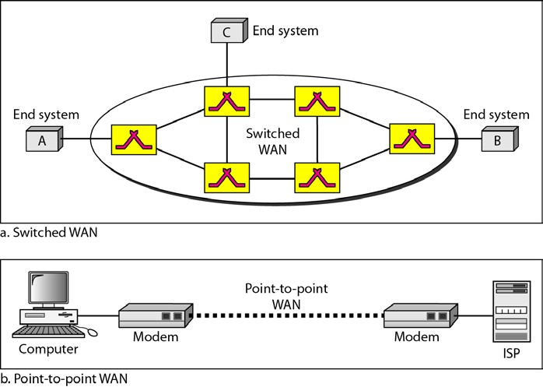
LANs are designed to allow resources to be shared between personal computers orworkstations. The resources to be shared can include hardware (e.g., a printer), software(e.g., an application program), or data. A common example of a LAN, found in manybusiness environments, links a workgroup of task-related computers, for example, engineeringworkstations or accounting PCs. One of the computers may be given a largecapacitydisk drive and may become a server to clients. Software can be stored on thiscentral server and used as needed by the whole group. In this example, the size of theLAN may be determined by licensing restrictions on the number of users per copy of software,or by restrictions on the number of users licensed to access the operating system.In addition to size, LANs are distinguished from other types of networks by theirtransmission media and topology. In general, a given LAN will use only one type oftransmission medium. The most common LAN topologies are bus, ring, and star.Early LANs had data rates in the 4 to 16 megabits per second (Mbps) range. Today,however, speeds are normally 100 or 1000 Mbps.
Wide Area Networks (WANs)
A wide area network (WAN) provides long-distance transmission of data, image, audio,and video information over large geographic areas that may comprise a country, a continent,or even the whole world. A
WAN can be as complex as the backbones that connect the Internet or assimple as a dial-up line that connects
a home computer to the Internet. We normally referto the first as a switched WAN and to the second as a point-to-point WAN (Figure 1.11).
Figure (1.11) WANs: a switched WAN and a point-to-point WAN
The switched WAN connects the end systems, which usually comprise a router (internetworkingconnecting device) that connects to another LAN or WAN. The point-to-pointWAN is normally a line leased from a telephone or cable TV provider that connects ahome computer or a small LAN to an Internet service provider (ISP). This type of WANis often used to provide Internet access.
An early example of a switched WAN is X.25, a network designed to provide connectivitybetween end users. A good exampleof a switched WAN is the asynchronous transfer mode (ATM) network, which is a
networkwith fixed-size data unit packets called cells. Another example ofWANs is the wireless WAN that is becoming more and more popular.

Slide 12
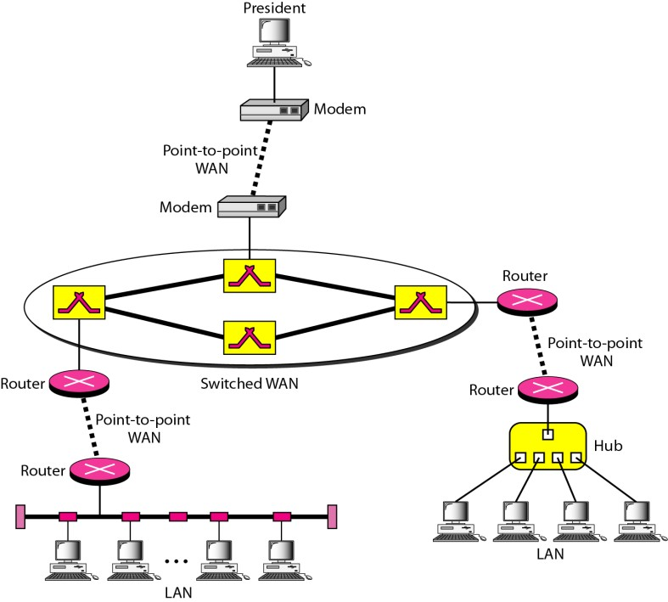
Metropolitan Area Networks (MANs)
A metropolitan area network (MAN) is a network with a size between a LAN and aWAN. It normally covers the area inside a town or a city. It is designed for customerswho need a high-speed connectivity, normally to
the Internet, and have endpointsspread over a city or part of city. A good example of a MAN is the part of the
telephonecompany network that can provide a high-speed (Digital Subscriber Line) DSL line to the customer. Anotherexample is the cable TV network that originally was designed for cable TV, but todaycan
also be used for high-speed data connection to the Internet.
Interconnection of Networks: Internetwork: - Today, it is very rare to see a LAN, a MAN, or a LAN in isolation; they are connectedto one another. When two or more networks are connected, they become aninternetwork, or internet.
As an example, assume that an organization has two offices, one on the east coastand the other on the west coast. The established office on the west coast has a bus topologyLAN; the newly opened office on the east coast has a star topology LAN. The president ofthe company lives somewhere in the middle and needs to
have control over the company from her home. To create a backbone WAN for connecting these three entities (two LANs and the president's computer), a switched WAN operated by a service provider such as a telecom company) has been leased. To connect the LANs to this switched WAN, however, three point-to- point WANs are required. These point-to-point WANs can be a high-speed DSL line offered by a telephone company or a cable modern line offered by a cable TV provider as shown in Figure 1.12.
Figure (1.12) a heterogeneous network made of four WANs and two LANs

Slide 13
THE INTERNET
The Internet has revolutionized many aspects of our daily lives. It has affected the waywe do business as well as the way we spend our leisure time. Count the ways you'veused the Internet recently. Perhaps you've sent electronic mail (e-mail) to a businessassociate, paid a utility bill, read a newspaper from a distant city, or looked up a localmovie schedule-all by using the Internet. Or maybe you researched a medical topic,booked a hotel reservation, chatted with a fellow Ali, or comparison-shopped for acar. The Internet is a communication system that has brought a wealth of information toour fingertips and organized it for our use.The Internet is a structured, organized system.
Brief History: -A network is a group of connected communicating devices such as computers and printers. An internet (note the lowercase letter i) is two or more networks that can communicate with each other. The
most notable internet is called the Internet (uppercase letter I), a collaboration of more than hundreds of thousands of interconnected networks. Private individuals as well as various organizations such as government agencies, schools, research facilities, corporations, and libraries in more than 100 countries use the Internet. Millions of people are users. Yet this extraordinary communication system only came into being in 1969.
In the mid-1960s, mainframe computers in research organizations were standalonedevices. Computers from different manufacturers were unable to communicatewith one another. The Advanced Research Projects Agency (ARPA) in the Departmentof Defense (DoD) was interested in finding a way to connect computers so thatthe researchers they funded could share their findings, thereby reducing costs and eliminatingduplication of effort.
In 1967, at an Association for Computing Machinery (ACM) meeting, ARPA presentedits ideas for ARPANET, a small network of connected computers. The idea wasthat each host computer (not necessarily from the same manufacturer) would beattached to a specialized computer, called an interface message processor (IMP). TheIMPs, in turn, would be connected to one another. Each IMP had to be able to communicatewith other IMPs as well as with its own attached host.
By 1969, ARPANET was a reality. Four nodes, at the University of California atLos Angeles (UCLA), the University of California at Santa Barbara (UCSB), StanfordResearch Institute (SRI), and the University of Utah, were connected via the IMPs toform a network. Software called the Network Control Protocol (NCP) provided communicationbetween the hosts.
In 1972, Vint Cerf and Bob Kahn, both of whom were part of the core ARPANETgroup, collaborated on what they called the Internetting Project. Cerf and Kahn's landmark1973 paper outlined the protocols to achieve end-to-end delivery of packets. Thispaper on Transmission Control Protocol (TCP) included concepts such as encapsulation,the datagram, and the functions of a gateway.
Shortly thereafter, authorities made a decision to split TCP into two protocols:Transmission Control Protocol (TCP) and Internetworking Protocol (IP). IP wouldhandle datagram routing while TCP would be responsible for higher-level functionssuch as segmentation, reassembly, and error detection. The internetworking protocolbecame known as TCP/IP.

Slide 14
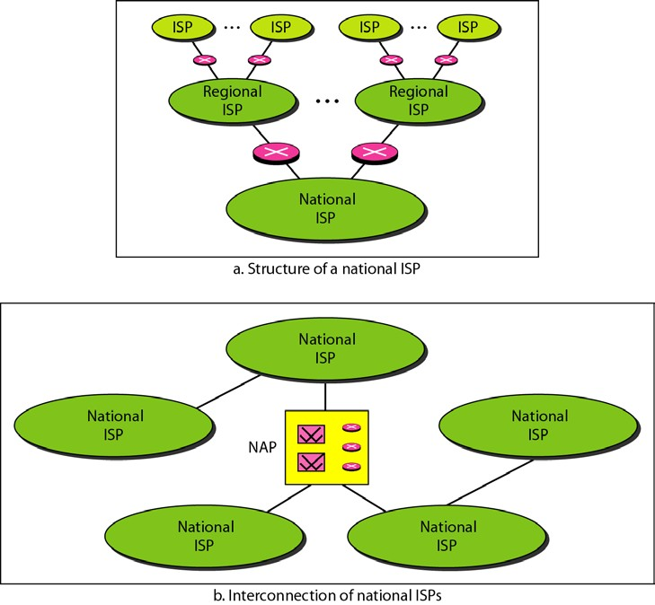
The Internet has come a long way since the 1960s. The Internet today is not a simple hierarchical structure. It is made up of many wide- and local-area networks joined by connecting devices and switching stations. It is difficult to give an accurate representation of the Internet because it is continually changing-new networks are being added, existing networks are adding addresses, and networks of defunct companies are being removed. Today most end users who want Internet connection use the services of Internet service providers (lSPs). There are international service providers, national service providers, regional service providers, and local service providers. The Internet today is run by private companies, not the government. Figure 1.13 shows a conceptual(not geographic) view of the Internet.
Figure (1.13) Hierarchical organization of the Internet
PROTOCOLS AND STANDARDS
Protocol:-In computer networks, communication occurs between entities in different systems. An entity is anything capable of sending or receiving information. However, two entities cannot simply send bit streams to each other and expect to be understood. For communication to occur, the entities must agree on a protocol. A protocol is a set of rules that govern data communications. A protocol defines what is communicated, how it is communicated, and when it is communicated. The key elements of a protocol are syntax, semantics, and timing.

Slide 15
Syntax: - The term syntax refers to the structure or format of the data, meaning the order in which they are presented. For example, a simple protocol might expect the first 8 bits of data to be the address of the sender, the second 8 bits to be the address of the receiver, and the rest of the stream to be the message itself.
Semantics: - The word semantics refers to the meaning of each section of bits. How is a particular pattern to be interpreted, and what action is to be taken based on that interpretation? For example,
does an address identify the route to be taken or the final destination of the message?
Timing: - The term timing refers to two characteristics: when data should be sent and how fast they can be sent. For example, if a sender produces data at 100 Mbps but the receiver can process data at
only 1 Mbps, the transmission will overload thereceiver and some data will be lost.
Standard:- Standards are essential in creating and maintaining an open and competitive market for equipment manufacturers and in guaranteeing national and international interoperability of data and telecommunications technology and processes. Standards provide guidelines to manufacturers, vendors, government agencies, and other service providers to ensure the kind of interconnectivity necessary in today's marketplace and in international communications.
Standards Organizations: - Standards are developed through the cooperation of standards creation committees, forums, and government regulatory agencies.
standards creation committees:-
  International Organization for Standardization (ISO).
  International Telecommunication Union-Telecommunication Standards Sector (ITU-T).
  American National Standards Institute (ANSI).
  Institute of Electrical and Electronics Engineers (IEEE).
  Electronic Industries Association (EIA).
Forums: - special-interest groups have developed forumsmade up of representatives from interested corporations. The forumswork with universities and users to test, evaluate, and standardize new
technologies.
Regulatory Agencies: - All communications technology is subject to regulation by government agencies such as the Federal Communications Commission(FCC) in the United States. The purpose of these agencies is to protect the public interest by regulating radio, television, and wire/cable communications.

